Slide 1


AHC
hackNagpur
Advanced Health Care
Implementing Technology for health
Team : DumbGeeks
1. Rohit Kumar
2. Abhishek Singh
3. Harshal Raikar
Hackathon : HackNagpur
01

Slide 2
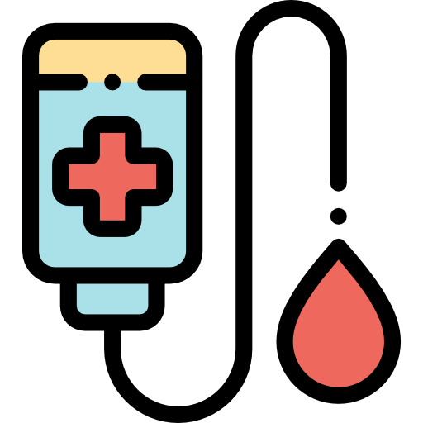
PROBLEM STATEMENT
hackNagpur
At some point in life more than 80% population could potentially need a blood donation in their lives. In 95% accidental cases the lives are lost due to either shortage of blood at time or due to lack of correct blood donation. There is no denying that the blood is available at blood banks but there is vast shortage of Reliable Blood donors in the society. we also currently don’t have any large scale Health Centred Online Platform or Community working for better health and care for the society just like any other Platforms such as LinkedIn, Quora etc. Even today people fear to donate blood because of some myths and misconceptions in the society. WHO stats has shown that in coming 5 to 10 years the deaths due to blood shortage are going to increase by 3-5%. In Diseases like blood cancer or other related diseases which require blood transufion like anemia, hemophilia, kidney & liver disease, Severe infection,Sickle cell disease many operations couldn’t happen properly or don’t happen in time due to the same non availability of blood on the time. There is an urgent need to tackle with this problem.

Slide 3

PROPOSED SOLUTION
hackNagpur
The Basic Idea
The idea is to Build an Online Health Centred Platform which promotes regular blood donations particularly in the 18-35 age demographics. “The motive is to Create and Sustain and Increase Reliable Blood Donors in the society.”

Slide 4
PROPOSED SOLUTION
hackNagpur
How to Achieve This ?
Creating a blood donation Centred Social Platform where a donor can join and Tell everyone that he/she just donated blood and get the well deserved recognition that the blood donors should get.
We have developed a web app where a donor can join by simple signup. The blood donor then can go to the blood donation section and Submit Their name With some required documents and other small details that he/she has donated blood. once the documents get verified by the admin a post appears in the home field just like a social platform showing all the weather people in the platform That he/she just to donated blood. Donor also gets a ranking in the hero-leaderboard of Blood donors according to the amount of blood donated.

Slide 5
PROPOSED SOLUTION
hackNagpur
Why would it work ?
When a blood donor donates blood he/she Gets a ranking As well as automatic community post that he/she just donated blood. Other People of Platform can like and comment the community post as well as the Leaderboard ranking Gives a lot of recognition to the blood donors who have Donated Blood.
This promotes other people Precisely new donors to donate blood for a good cause and also breaks lot of maths related with the blood donation. It creates awareness among the people that donating blood is not a very hard task and also makes The present blood donors to sustain and donate more blood for mankind.

Slide 6


hackNagpur
Blood donors can donate blood and submit a report once his/her document gets verified by admin he/she will get a live-saver (`hero`) rank on our community donor list. "We think that if you are a `hero` you should get recognition", which in turn inspires other new donors to come forward and donate for mankind.
3.
1.
Interactive Medi-BoT which tells solves user first hand queries in no time with in-built BMI calculator and other related features.
Just like any other social media platforms the main motive of this platform is to create a community of people who care about thier health as well as of others. A Micro-blog posting platform where people can share thier experiences about thier medical conditions, how they tackled them or any other life experinces where their health was challenged. In India there are very few Health centered community platforms.
4.
2.
A smart BMI-Calculator which not only calculates your BMI but also tells your recommended weight, daily calorie requirements, a complementary diet also.
Moreover 3D yoga asanas and Covid support has also been provided.

Slide 7

TECH STACK
hackNagpur
1.
React
A JavaScript library for building user interfaces
Firebase
Backed by Google and loved by app development
teams - from startups to global enterprises
2.
3.
MATERIAL-UI
React components for faster and easier web development. Build your own design system, or start with Material Design.
4.
HTML5 , CSS3 & JavaScript
The building blocks for every web-app

Slide 8
hackNagpur
THANK YOU

